Slide 1
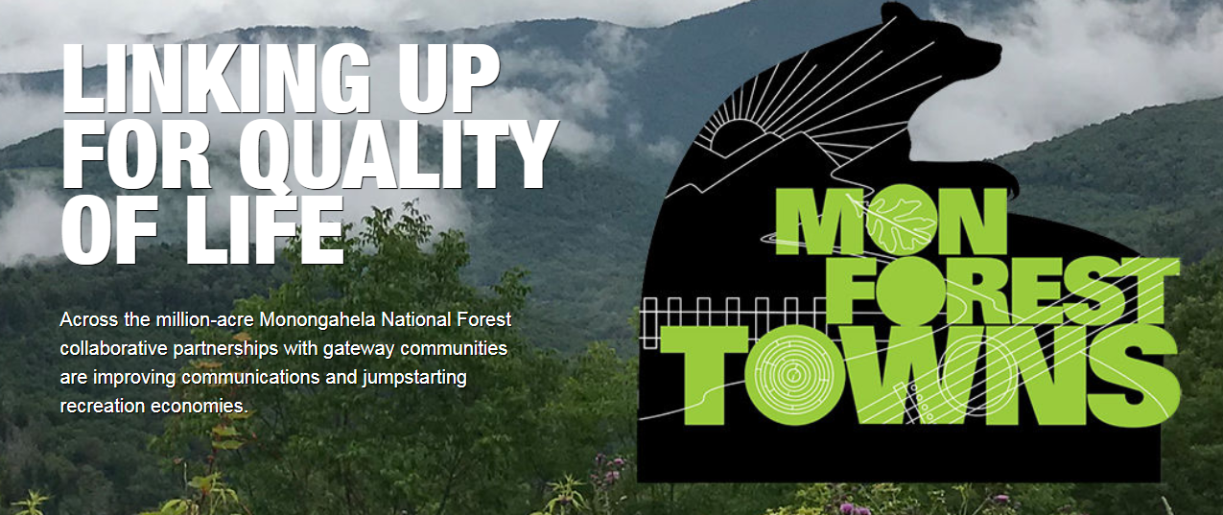
Mon Forest Towns Summit
June 13, 2019
Elkins, WV
Notes:
Brent- intro, turn over to Hiwot

Slide 2
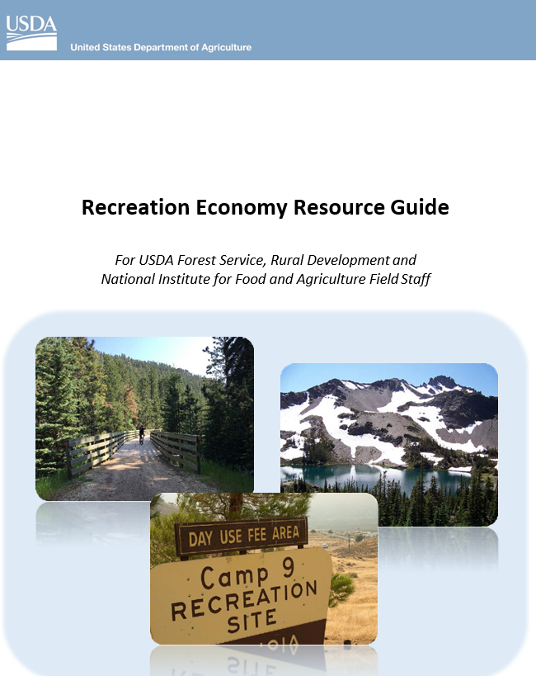



2018 One USDA
Modernizing USDA mission support activities to be more efficient and effective by utilizing enterprise solutions;
Serving customers and improving the delivery of USDA’s core missions;
2017 USDA Recreation Economy Resource Guide

Slide 3
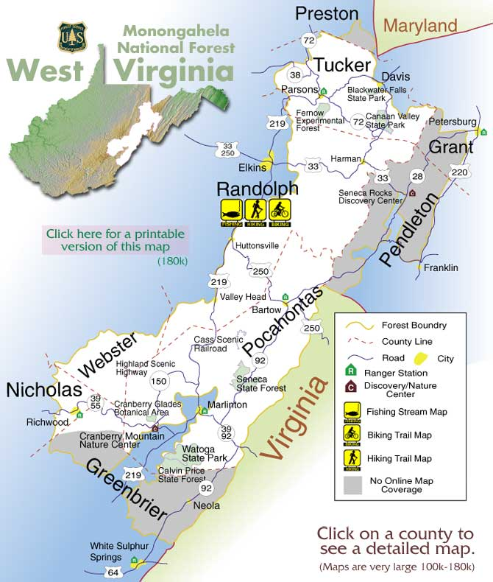
Mon Forest Towns
Davis
Thomas
Parsons
Petersburg
Franklin
Marlinton
Richwood
Cowen/Webster Springs
Elkins
White Sulphur Springs
Thomas
Cowen
White Sulphur Springs

Slide 4

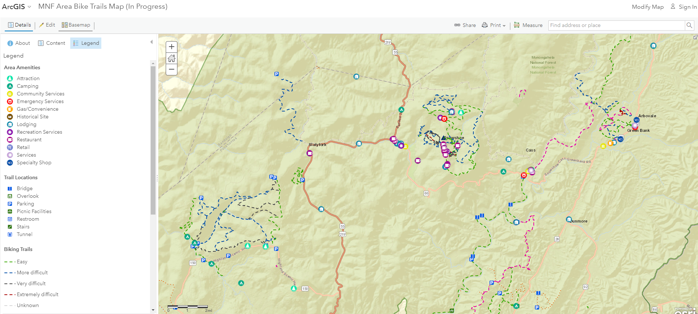
WVU rural tourism design Team
  Extension Service
    Project Coordination
    Facilitation of Partnership Meetings
  Natural Resources Analysis Center
    GIS Mapping of Forest and Community Resources
  Recreation, Parks, and Tourism Resources
    Impact Indicator Measurement
  Landscape Architecture
    Site Design for Community Projects
  Graphic Design Program
    Social Design and Community Branding
  Master of Public Administration
    Capstone research
  School of Media
    Martin Hall Agency

Slide 5
https://publicinterestdesign.sandbox.wvu.edu/mon-forest-towns

Slide 6
Community assessments
Goals for your community that you would hope to achieve through participation in the MNF Recreation Economies initiative
Identify assets
Improve community access to MNF
Improved branding and wayfinding
Improved local knowledge of area resources
Improved signage to key recreation areas
Collaborative CVB marketing across the region
Identifying barriers
Change mentality and be more open to working in a positive direction and allowing change
Improved networking and communication with Forest Service personnel
Move forward together to improve

Slide 7
Community assessments
Tourism Management
Community Interaction
Transportation and Signage
Community Information
Hospitality
Aesthetics
Tourism Assets
Environment
Tourist Education
Services
Accessibility
Visitor Motives
Main Downtown Business Area
Target Market(s)
Strengths, Challenges, Opportunities, and Goals
Tables
1 = Strongly Disagree | 2 = Disagree | 3 = Somewhat Disagree | 4= Somewhat Agree | 5= Agree | 6 = Strongly Agree
Overall Mean (below 3 indicates collective challenge)
Standard Dev. (low indicates similar responses, high indicates varied responses)
Comments

Slide 8
Services Comments
Davis comments:
  Davis Riverfront park has a little public restroom
Marlinton comments:
  Public restrooms are available but not advertised
Richwood comments:
  Public restrooms locked at city park unless there is an event
Elkins comments:
  Trailheads are available but might be hard to find

Slide 9
MFT Asset map & website
Collaborators
WVU Extension Family & Community Development
Natural Resource Analysis Center (WVU Davis College)
Graphic Design (WVU College of Creative Arts)
Robin Bruns (Poca Trails, independent contractor)
Recreation, Parks and Tourism Resources (WVU Davis College)
Monongahela National Forest
Local stakeholders (CVB’s, etc.)

Slide 10
MFT Asset map & website
Tasks
Data development: tourism amenity points
Data development: recreational features
Web map development: create enhanced interactive online map to highlight tourism amenities and unique features
Web site development: complete user experience incorporating web map and related content

Slide 11
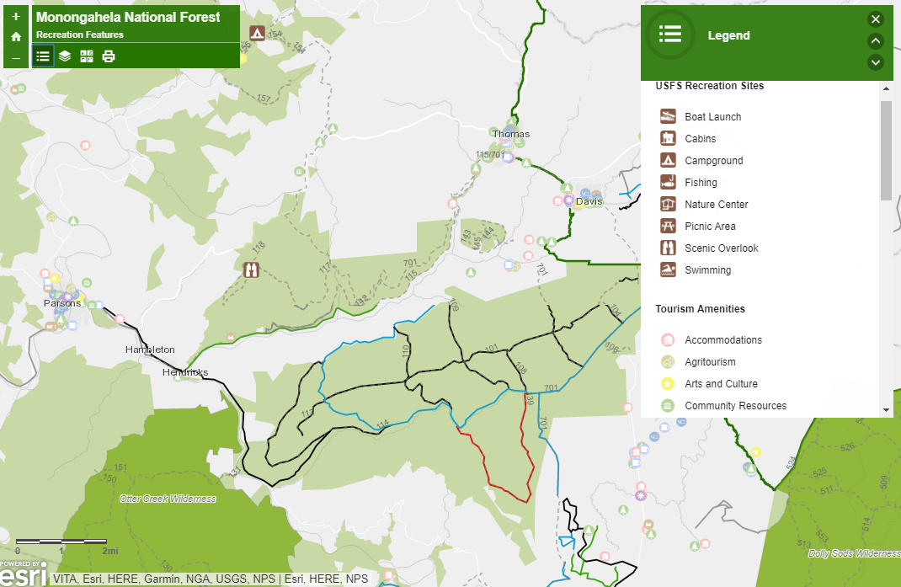
Draft web map application (basic)
Current Layers:
Tourism amenities (incomplete)
USFS recreation sites
USFS trails
Biking, hiking, XC trails
Whitewater stream trails
Wilderness areas
Recreation areas
USFS Surface ownership
Functions:
Turn layers on/off
Click on feature; view popup
Print map
Change basemap layer
URL: https://bit.ly/2KJoCfj

Slide 12
Task details: Data development
Tourism amenity development
  Includes lodging, accommodations, recreation sites, restaurants, services etc.
  Data includes address, phone, email, website, photos if available
  Considered complete for some counties (Pocahontas, Tucker)
  Incomplete for others (especially Nicholas, Preston, Randolph)
  New funding will allow us to complete & verify existing data for Monongahela National Forest & surrounding counties
  New funding will allow for website integration

Slide 13
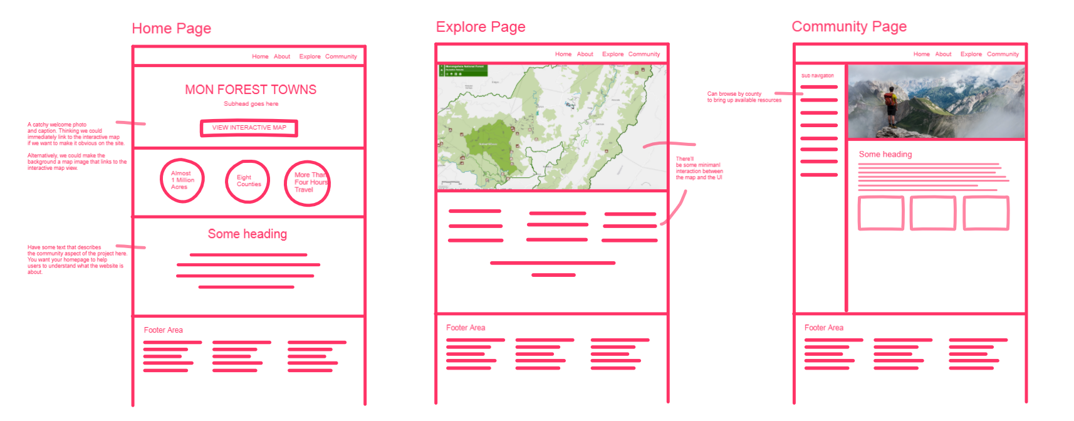
monforesttowns.com

Slide 14
Phase 1 summer and fall 2019 (funded)
Asset Map
Data Gathering and Assessment
Product Design Coordination
Custom Base Map Vector Tile Design
ArcGIS Web Map Development
Website
User experience design
Branding consultation
Content production and editing (images, text, etc)
PHASE 2 (NOT FUNDED)
Web development and ArcGIS integration
Web development tools
Domain and hosting registration
Usability testing

Slide 15
Ongoing input/support needed
Data collection and verification for map
Website design and functionality
Photos and content for website
Itineraries

Slide 16
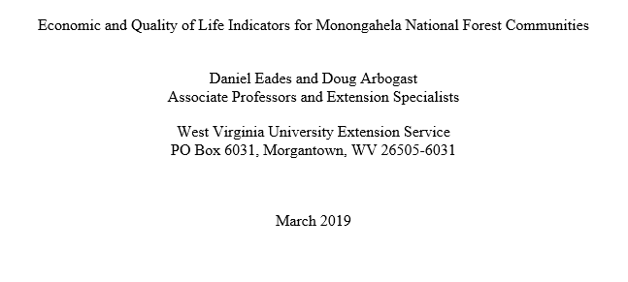
Impact indicators

Slide 17
Indicators to Track
Employment and Industry (by sector)
Travel expenditures
Travel related tax revenue
Hotel/motel tax collections
Employment and earnings (by sector)
Population change
Educational attainment
Income
Second homes
Business trends and impacts

Slide 18


MNF Rec Economies Business Development Initiative
Woodlands Development Group & Natural Capital Investment Fund – Nonprofit Community Development Financial Institutions (CDFIs)
Goal: diversify and advance the local economies of the Mon National Forest gateway communities by strengthening and capitalizing on the area’s natural assets by providing targeted business services, technical assistance, and access to capital.
$452,500 = Appalachian Regional Commission – WV State
$452,500 = U.S. Economic Development Administration
$300,000 = Benedum Foundation
$50,000 = USDA Rural Business Development Grant
= $1,255,000

Slide 19
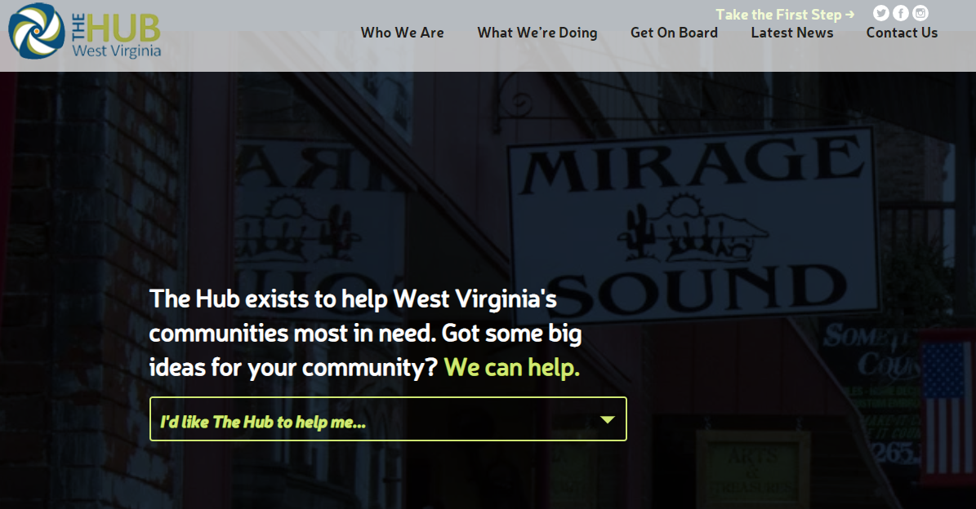

Slide 20



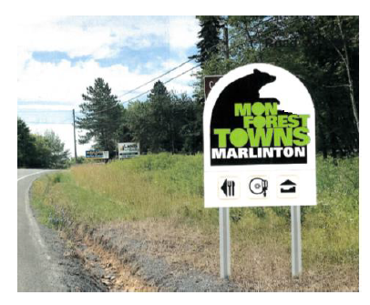
Developing a Common identity
Working with community and Forest Service, a brand would be
co-designed that residents could see as opportunities to be part of the forest story and allow for cooperation among communities with a vision of offering a week of experiences for visitors that allow for towns who identify with nearby attractions to be recognized as unique within a trail of linked opportunities.
https://publicinterestdesign.sandbox.wvu.edu/mon-forest-towns/style-manual

Slide 21
Breakout session
  What are the Pros/Cons of a regional partnership?
  (5 mins)
  What would your desired outcomes be from the MFTP?
  (10 mins)
  MOU Feedback
  (10 mins.)
  Is your community ready to commit a board member?
  (5 mins)

