Slide 1
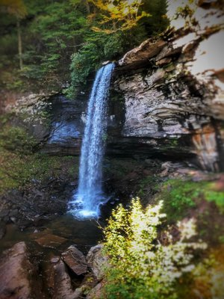
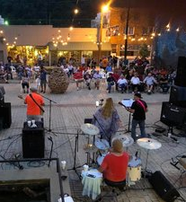
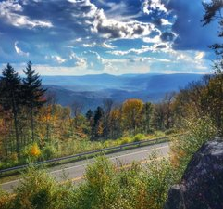

Slide 2
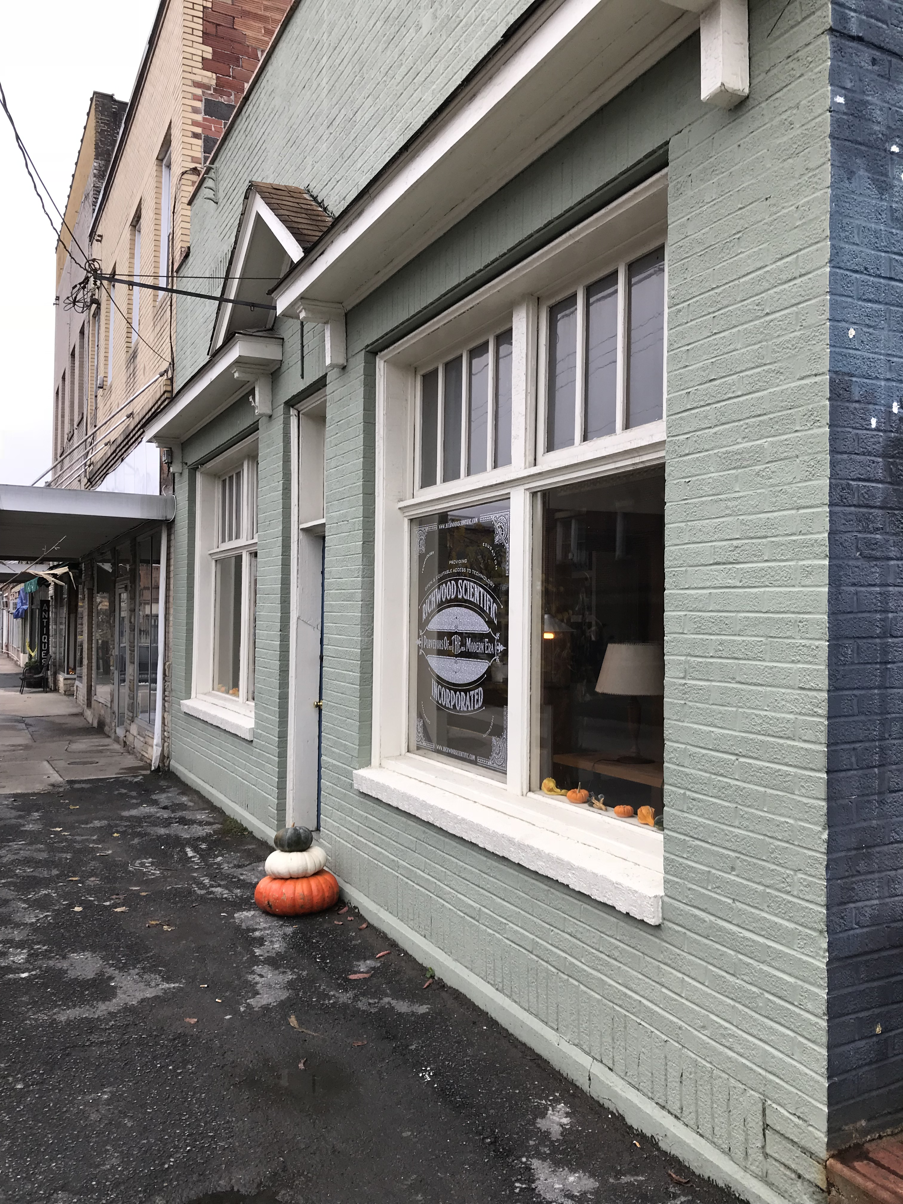
Blueprint team
HubCap team
#richwoodrising
Richwood Chamber
Richwood Scientific
Appalachian Gateway team
Forest Service
New River Gorge Trail Alliance
Region 4

Slide 3
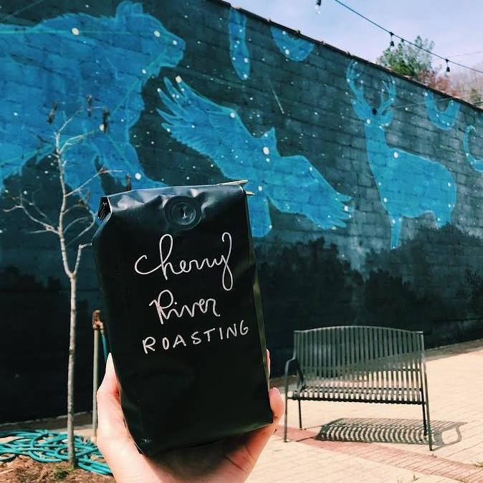
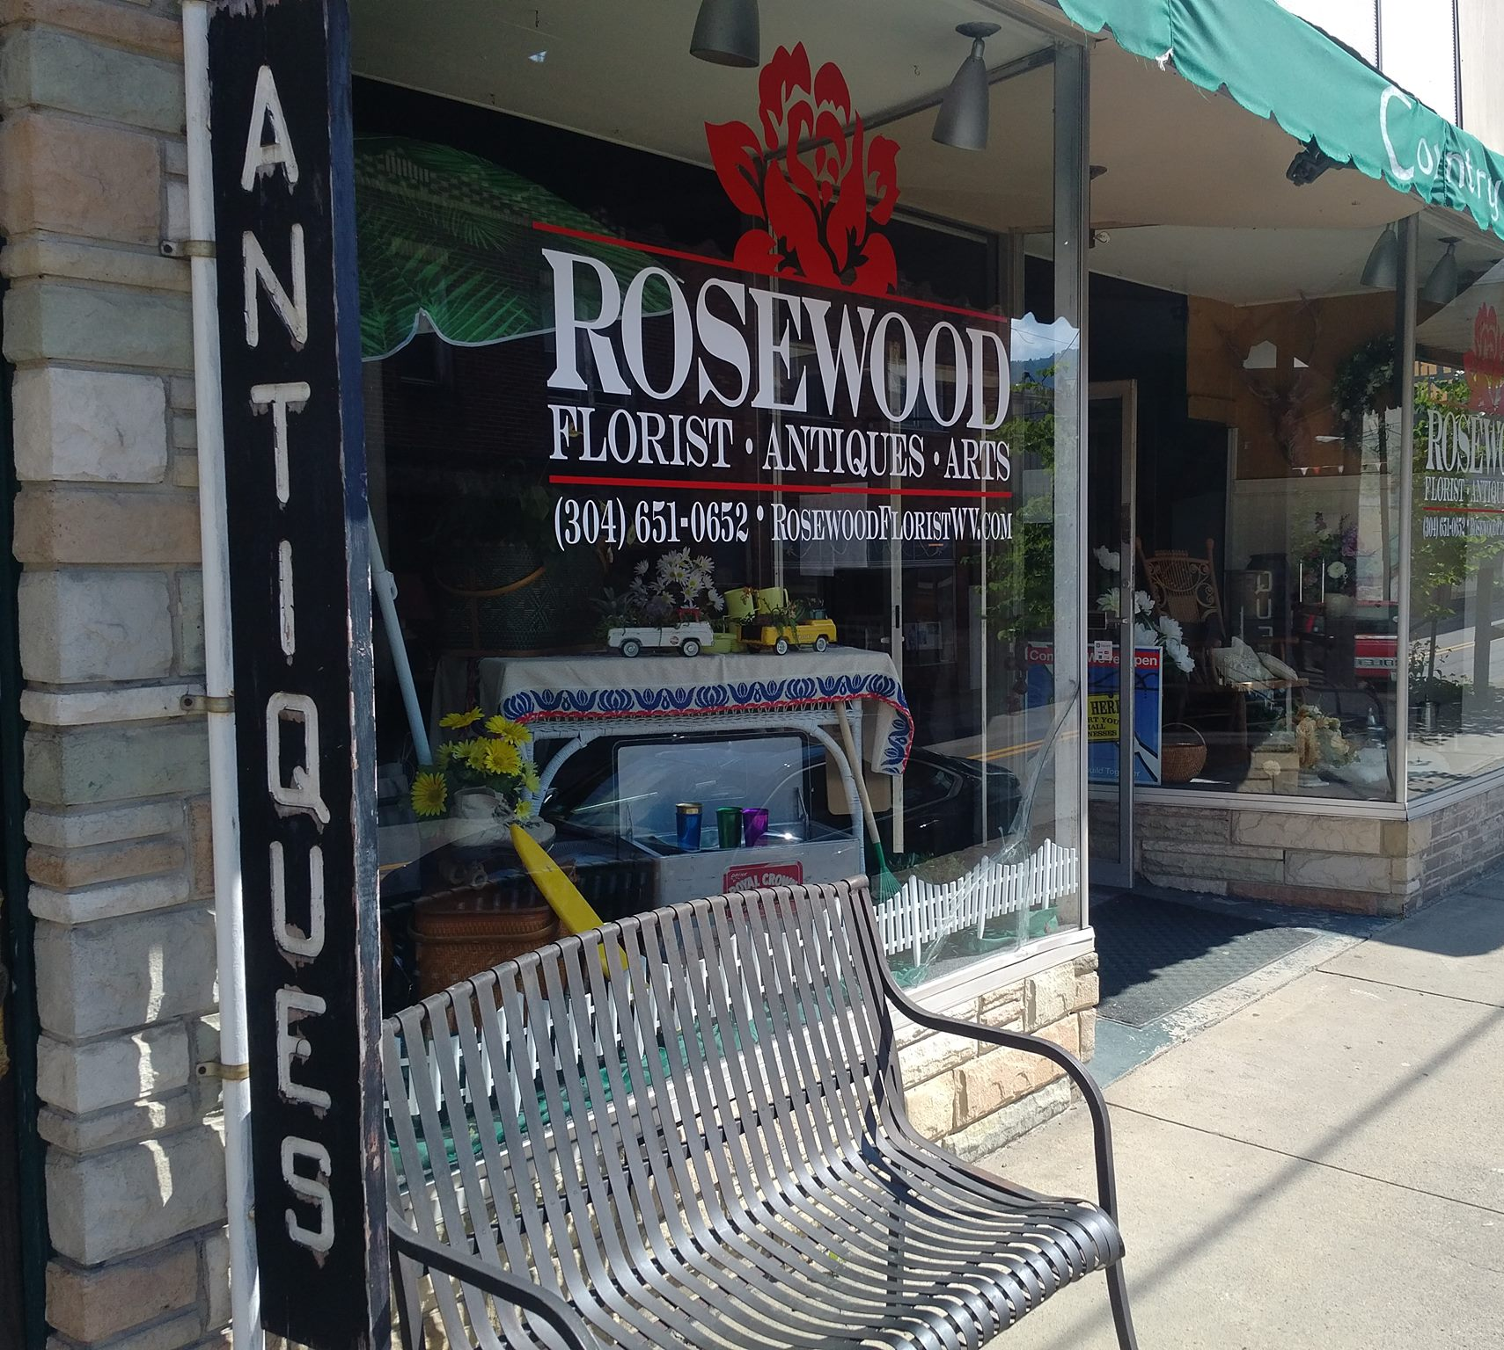

Slide 4
riderichwood.com
Collaboration of 15 businesses for a large ad buy in a regional motorcycle map.
Concerted efforts to be a better motorcycle destination

Slide 6
What we hope to gain?
Collaborative marketing
Better connectivity
Cross promotional opportunities

